Slide 1
Inserting data Dr Mariana Rocha School of Computer Science
CPMU 2007 Databases 1, Lecture 2

Slide 2
Learning Objectives
Understand how to populate a table
Understand how to modify the structure of a table
Familiarise with how to access and display data from a table

Slide 3
Inserting data

Slide 4
Inserting data - what to consider?
The format of the table, considering the columns and their constraints. Make sure VARCHAR, TEXT, DATE and TIMESTAMP fields have their values surrounded by single quotes when inserted.
You can do either:
A full INSERT
This inserts a value for every column in the table.
A partial INSERT
This inserts some values but accepts the default values for other columns.

Slide 5
Adding a new row
INSERT INTO table (column1, column2, ... column_n ) VALUES (expression1, expression2, ... expression_n );
users
userId (PK) | 001
userName | John
userSurname | Smith
INSERT INTO users VALUES (001, 'John', 'Smith');

Slide 6
Adding a new row without column specification
If we do not include a column list, the DBMS assumes you are inserting data in the column order it expects. That is useful if you know the order and you are filling out all the attributes.
If userId was SERIAL data type, we would need to list the columns before inserting data, so we can skip the serial type column.
INSERT INTO users VALUES (001, 'John', 'Smith');
INSERT INTO users (userId, userName, userSurname) VALUES (001, 'John', 'Smith');

Slide 7
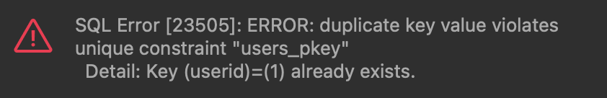
Possible errors – constraint violation
This is the code to create the table users:
Suppose we run the following code twice:
We will get the following error on Dbeaver:
What does it mean?
CREATE TABLE users (userId INT PRIMARY KEY, userName VARCHAR(30), userSurname VARCHAR(30));
INSERT INTO users VALUES (001, 'John', 'Smith’);
INSERT INTO users VALUES (001, 'John', 'Smith');

Slide 8
Possible errors – constraint violation
We’ve already inserted a row with a userId = 001.
If we try to insert a second row with a userId with the value 001:
We are trying to add a duplicate primary key (not allowed)
Action: Either remove the unique restriction or do not insert the key

Slide 9
Possible errors – connected tables
Let’s go back to the database we created to store information about movies, actors and movie cast:
CREATE TABLE movies (movieId SERIAL PRIMARY KEY, movieTitle VARCHAR(50), releaseYear INT, director VARCHAR(30), budget INT, profit INT);
CREATE TABLE actors(actorID SERIAL, actorName VARCHAR(30),CONSTRAINT actors_pk PRIMARY KEY (actorID));
CREATE TABLE movie_cast(movieID SERIAL, actorID SERIAL, rolePlayed VARCHAR(50),CONSTRAINT cast_actor_fk FOREIGN KEY (actorId) REFERENCES actors (actorID), CONSTRAINT cast_movie_fk FOREIGN KEY (movieId) REFERENCES movies (movieID), PRIMARY KEY (movieID, actorID));

Slide 10
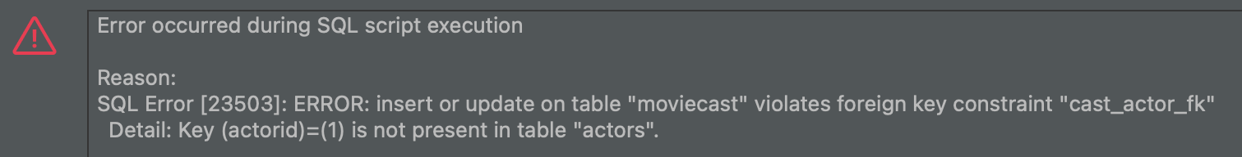
The order of insertion follows the order of creation
Always follow the order used to create the tables. For example, if we try to insert into the table movieCast before inserting into the table movies and actors, we get the following error:
That’s because there is no movieId = 1 or actorId = 1 inserted yet, so table movieCast cannot populated using that foreign key.
The order of inserting data should be into the table movies, then table actors, then table movieCast.
INSERT INTO movie_cast (movieId, actorId, rolePlayed) VALUES (1, 1, ‘Jack Dawson’);

Slide 11
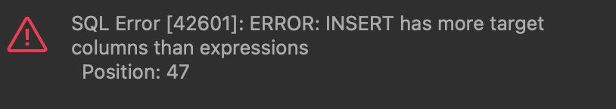
Insert the correct number of values
Suppose we run the following statement:
We get the following error. Why?
INSERT INTO movies (movieTitle, releaseYear, director, budget) VALUES ('Jumanji: Welcome to the Jungle', 2017, 'Jake Kasden’);

Slide 12
Insert the correct number of values
Suppose we run the following statement:
We get the following error. Why?
We need to provide a value for every column the DBMS is expecting a value for.
There is an equivalent error: Too many values, which happens when we try to insert more values than the DBMS is expecting.
INSERT INTO movies (movieTitle, releaseYear, director, budget) VALUES ('Jumanji: Welcome to the Jungle', 2017, 'Jake Kasden’);

Slide 13
Altering the table

Slide 14
Alter table
Once tables are created, they can be modified using the ALTER TABLE statement to:
Add a new column
Modify an existing column
Define a default value for the new column
Drop a column
Add or drop a constraint

Slide 15
Alter table - syntax
ALTER TABLE tableName
[ADD | DROP | ALTER | RENAME] ... ;

Slide 16
Alter table – Adding columns
For example, we can add a column genre to our table movies.
We just need to use the ALTER TABLE command:
CREATE TABLE movies (movieId SERIAL PRIMARY KEY, movieTitle VARCHAR(50), releaseYear INT, director VARCHAR(30), budget INT, profit INT);
ALTER TABLE movies ADD COLUMN genre VARCHAR(20);

Slide 17
Alter table – Modifying a column
We can also change a column, modifying its data type:
Or renaming it:
ALTER TABLE movies
ALTER COLUMN director TYPE TEXT;
ALTER TABLE actors
RENAME COLUMN actorName TO fullName;

Slide 18
Alter table - Dropping columns
To drop or remove a column in an existing table:
ALTER TABLE table_name DROP COLUMN column_name;
For example:
ALTER TABLE Movie DROP COLUMN director;

Slide 19
Updating existing records
The keyword UPDATE can update field values in one or more records in a table. However, only one table may be updated at a time. Check the syntax below.
UPDATE tablename
SET field1= new_value1, field2 = new_value2 WHERE search condition;

Slide 20
Updating existing records
UPDATE movies
SET genre = ‘Science fiction'
WHERE movieTitle = ‘Inception';
UPDATE movies
SET genre = ‘Action'
WHERE movieTitle = ‘The dark knight';
All rows where the condition is true have the columns set to the given values
If no condition is given, all rows are changed, so BE CAREFUL

Slide 21
Accessing data
Where is the data in the database?
What is the database structure?
How is each row identified uniquely?
What items of data do you need?
You need to know the constraints. For example:
‘I only want the items purchased in the last month.’
‘I only want to bill for items not paid for.’

Slide 22
Select statement
This is the most powerful and complex of SQL statements. The structure is simple:
There are other rules that can be added later.
SELECT columns
FROM table WHERE condition;

Slide 23
Select everything
To select all rows and columns from a table called movies, we can run the following statement:
The * denotes all available columns.
SELECT * FROM movies;

Slide 24
Select specific data - Projection
Let’s select only the column called movieTitle from the table movies. By picking one single column, we have taken a projection from the table.
SELECT movieTitle FROM movies;

Slide 25
The WHERE clause
As we have seen in other statements, the WHERE clause is related to a condition. For data selection, we use the WHERE clause to retrieve data matching some criteria.
SELECT * FROM movies WHERE genre = ‘Drama’;

Slide 26
Basic operations to build expressions
Operator | Possible operations | Syntax
Comparisons | <, =, >, <=, >=, <> ( means “not equal to”) | Expression { < | = | <= | >= | <> } Expression
AND, OR, NOT | Evaluate any operand(s) that are boolean expressions (orig_airport = 'SFO') OR (dest_airport ='GRU') -- returns true | { Expression AND Expression | Expression OR Expression | NOT Expression }

Slide 27
Examples
--Find the title and budget of all movies with a Movie ID <3?
SELECT movietitle, budget, director FROM movies WHERE movieid <5;
--And directed by Christopher Nolan?
SELECT movietitle, budget, director FROM movies WHERE movieid < 5 AND director ='Christopher Nolan';
--What happens if we change the AND to OR?
SELECT movietitle, budget, director FROM movies WHERE movieid <5 OR director='Christopher Nolan';
--Find the title and budgets of movies not directed by directorid 2?
SELECT movietitle, budget, director FROM movies WHERE director <> 'Christopher Nolan';

Slide 28
Between
Operator | Explanation | Syntax
BETWEEN | Tests whether the first operand is between the second and third operands. The second operand must be less than the third operand. Applicable only to types to which <= and >= can be applied. | Expression [ NOT ] BETWEEN Expression AND Expression
--Find the titles of all movies with a budget between 100 and 900
SELECT movietitle FROM movies WHERE budget BETWEEN 100 and 900;

Slide 29
In
Operator | Explanation and Example | Syntax
IN | The IN operator allows you to specify multiple values in a WHERE clause. The IN operator is a shorthand for multiple OR conditions. SELECT * FROM Customers WHERE Country IN ('Germany', 'France', 'UK’); SELECT * FROM Customers WHERE Country NOT IN ('Germany', 'France', 'UK'); | { Expression [ NOT ] IN TableSubquery |

Slide 30
SELECT * FROM Customers
WHERE Country IN ('Germany', 'France', 'UK’);
CustomerID | CustomerName | ContactName | Address | City | PostalCode | Country
1 | Alfreds Futterkiste | Maria Anders | Obere Str. 57 | Berlin | 12209 | Germany
2 | Ana Trujillo Emparedados y helados | Ana Trujillo | Avda. de la Constitución 2222 | México D.F. | 05021 | Mexico
3 | Antonio Moreno Taquería | Antonio Moreno | Mataderos 2312 | México D.F. | 05023 | Mexico
4 | Around the Horn | Thomas Hardy | 120 Hanover Sq. | London | WA1 1DP | UK
5 | Berglunds snabbköp | Christina Berglund | Berguvsvägen 8 | Luleå | S-958 22 | Sweden
6 | Blauer See Delikatessen | Hanna Moos | Forsterstr. 57 | Mannheim | 68306 | Germany
7 | Blondel père et fils | Frédérique Citeaux | 24, place Kléber | Strasbourg | 67000 | France
8 | Bólido Comidas preparadas | Martín Sommer | C/ Araquil, 67 | Madrid | 28023 | Spain
9 | Bon app' | Laurence Lebihans | 12, rue des Bouchers | Marseille | 13008 | France
10 | Bottom-Dollar Marketse | Elizabeth Lincoln | 23 Tsawassen Blvd. | Tsawassen | T2F 8M4 | Canada

Slide 31
SELECT * FROM Customers
WHERE Country NOT IN ('Germany', 'France', 'UK’);
CustomerID | CustomerName | ContactName | Address | City | PostalCode | Country
1 | Alfreds Futterkiste | Maria Anders | Obere Str. 57 | Berlin | 12209 | Germany
2 | Ana Trujillo Emparedados y helados | Ana Trujillo | Avda. de la Constitución 2222 | México D.F. | 05021 | Mexico
3 | Antonio Moreno Taquería | Antonio Moreno | Mataderos 2312 | México D.F. | 05023 | Mexico
4 | Around the Horn | Thomas Hardy | 120 Hanover Sq. | London | WA1 1DP | UK
5 | Berglunds snabbköp | Christina Berglund | Berguvsvägen 8 | Luleå | S-958 22 | Sweden
6 | Blauer See Delikatessen | Hanna Moos | Forsterstr. 57 | Mannheim | 68306 | Germany
7 | Blondel père et fils | Frédérique Citeaux | 24, place Kléber | Strasbourg | 67000 | France
8 | Bólido Comidas preparadas | Martín Sommer | C/ Araquil, 67 | Madrid | 28023 | Spain
9 | Bon app' | Laurence Lebihans | 12, rue des Bouchers | Marseille | 13008 | France
10 | Bottom-Dollar Marketse | Elizabeth Lincoln | 23 Tsawassen Blvd. | Tsawassen | T2F 8M4 | Canada

Slide 32
Like
Operator | Explanation and Example | Syntax
LIKE | The LIKE operator is used in a WHERE clause to search for a specified pattern in a column. There are two wildcards often used in conjunction with the LIKE operator: 1. The percent sign (%) represents zero, one, or multiple characters 2. The underscore sign (_) represents one, single character | CharacterExpression [ NOT ] LIKE CharacterExpression WithWildCard [ ESCAPE 'escapeCharacter']

Slide 33
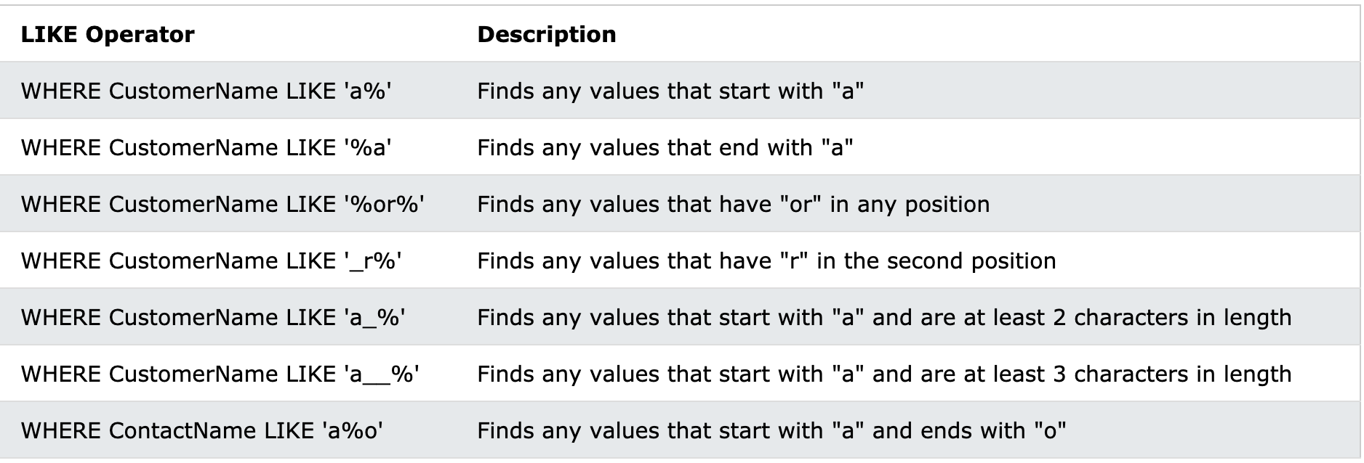
Like

Slide 34
Like
--Find the names of all movies starting with B?
SELECT movietitle FROM movies WHERE movietitle LIKE 'B%';
--Find the names of all movies with a letter a somewhere in their name?
SELECT movietitle FROM movies WHERE movietitle LIKE '%a%';
--And does not start with a J
SELECT movietitle FROM movies WHERE movietitle LIKE '%a%' AND movietitle NOT LIKE 'J%';
--Movie that starts with The
SELECT movieTitle, releaseYear, director FROM movies WHERE movieTitle LIKE 'The%';

Slide 35
Changing output
Once we run the SELECT statement, the output will use the attribute names decided during the DDL implementation. You can change it so the user can better view the selected data.
SELECT movieTitle "Title", director "Director" FROM movies WHERE movieId BETWEEN 1 AND 3;

Slide 36
Naming the techniques we have used
Projection – filtering out unwanted columns.
Restriction – filtering out unwanted rows using conditions
Renaming – using alternate titles

